Slide 1
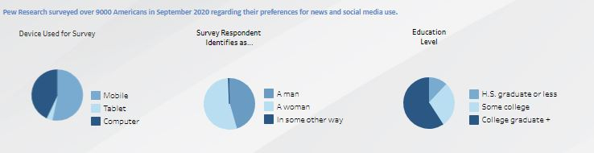
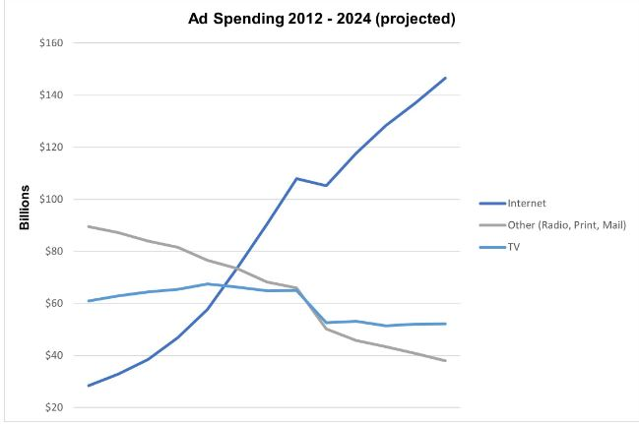
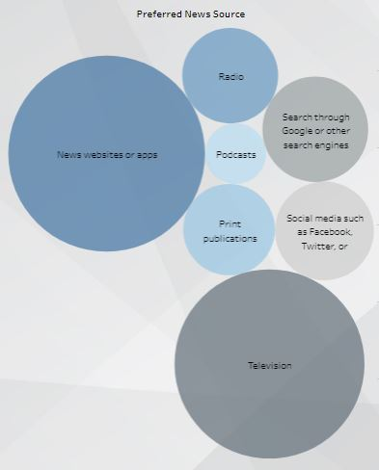
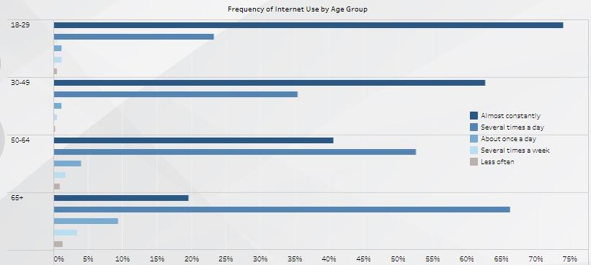
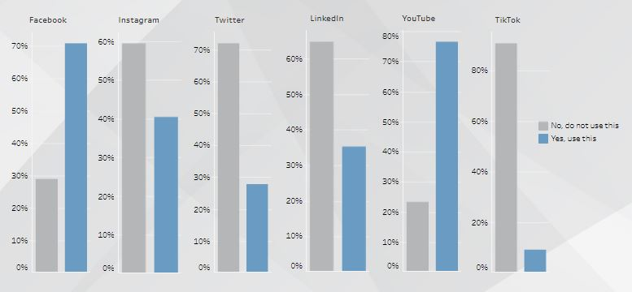
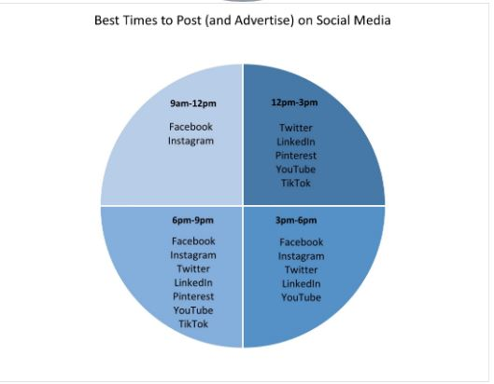
Shifting to Online Advertising from Traditional Media Team 47: Crystal Brinkley, Jimmy Wambua, AJ De Castro
Highlights
-Young adults are almost constantly on the internet
-Majority of users are on Facebook, Instagram, and YouTube
-We created a dashboard that shows what devices users use the most and times they are on social media
Background
Advertising is an important wealth-building tool companies use but the number of consumers have transitioned over to social medias in the new digital world. We analyzed the following: Costs, Platforms used, Popular times to post, etc
Data
The main dataset was taken from Pew Research and used to create an interactive dashboard on Tableau. We added information from 2 smaller datasets regarding ads spending and when to post on social media for better reach.
Insights
Businesses should target audiences of both genders who are using Computers and Mobile devices on social media sites such as Facebook and YouTube to maximize ad reach and increase ad views, engagement from users, and convert them to paying customer for the businesses’ product services.

